Slide 1
Data Science in Clinical Trials
Fundamentals of Data Elements and Integration
New Investigator Clinical Trials Course - August 2022
#SolveCancerTogether
Lam Pho, Chief Information Officer, CCTG
Wei Tu, Senior Biostatistician, CCTG; Assistant Professor, Department of Public Health Sciences, Queen’s University

Slide 2
Learning Objectives
To understand the how clinical data sciences can support the collection, management, and analysis of clinical data
Define data science, how it applies to clinical trials, data sources and types, teams involved
To review the current adoption of data science at CCTG
Review CCTG’s active projects
To review the future of data science at CCTG
Review CCTG’s short and long-term goals, potential uses for clinical trial sponsors and sites

Slide 3
CCTG Scientific Agenda
Understand Cancer Biology and Use this Knowledge to Improve Cancer Therapies and Outcomes
Patient Reported Data
Reduce the Burden of Cancer and Its Treatment for Patients and Their Carers
Real-World Data
Improve Cancer Care by Demonstrating the Value of Cancer Treatments
Correlative Science Data

Slide 4
What is Data Science?
Data Science is an interdisciplinary field that extracts knowledge and insights from structured and unstructured data
Domain
Expertise & Knowledge
Isn’t it just applied statistics? Maybe
Is it part of computer science? Not quite
Is it a legitimate science? On its way
Does it work? If used well and right
Potential use in Cancer Clinical Trials? HUGE
Research & Analysis
Processing &
Development
Data
Science
Mathematics &
Statistics
Computer
Science & IT
Machine
Learning

Slide 5
Poll 1

Slide 6
What is Clinical Data Science?
Clinical data science applies the methods and insights of data science with clinical data
Clinical data scientists work within clinical trials to in data management and analysis
Clinical data science incorporates biostatistics, clinical programming, clinical data management

Slide 7
Types of Data
Structured
Quantitative data that consists of numbers and values, relational data, etc.
e.g. CRF data, patient demographics
Unstructured
Qualitative data that consists of audio, video, sensors, descriptions, text, etc.
e.g. DICOM images, Physician notes/narratives
Semi-Structured
Lies midway between structured and unstructured data; doesn't have a specific relational or tabular data model but includes tags and markers that scale data into records and fields in a dataset
Consists of free text or data partially annotated with some specific keywords or metadata from a controlled terminology.
e.g. data repositories, ClinicalTrials.gov

Slide 8
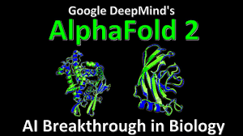
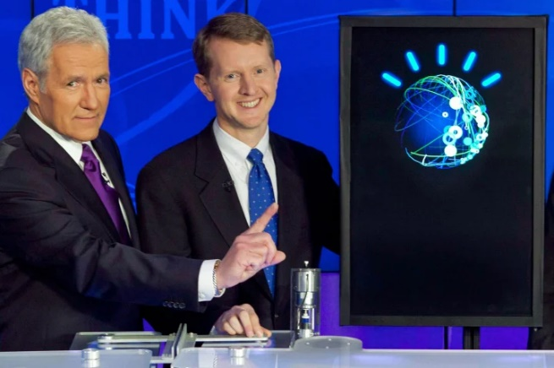
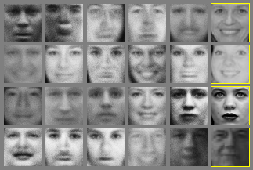
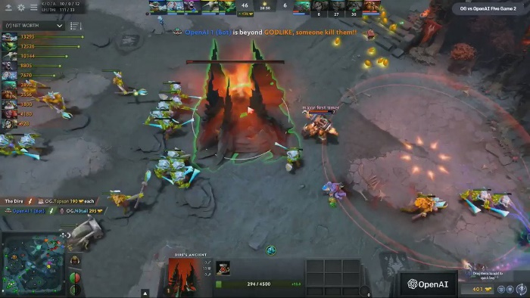
Data Science/AI Success Story

Slide 9
Data Science in Cancer Research and Trials
Cancer Research
Diagnosis
Early detection
Biomarkers
Prognosis prediction
Personalized patient care
…
Cancer Clinical Trials
Biomarker discovery
Adaptive trials
Meta analysis
Clinical trials + Real world data
Data Sharing
Do better at what we are already doing
…

Slide 10
Challenges
Operational challenges
Ethics
Volume of data
Cost
Heterogeneity (data, disease, patient, treatment, etc.)
Ethics
Data literacy
Data Privacy
Regulations

Slide 11
Health Data Platforms

Slide 12
Data Science Platform at CCTG
Patients
Clinicians
Correlative Scientists
Statisticians
Clinical Research Associates
AI researchers
Heath Economists
Policymakers
Regulators
…
Clinical Trial Data
Correlative Science
Data
Sharable, Generalizable,
Transparent,
Efficient,
Knowledge translation
Data Science Platform at CCTG
#SolveCancerTogether
Real-world Data
Patient reported Data

Slide 13
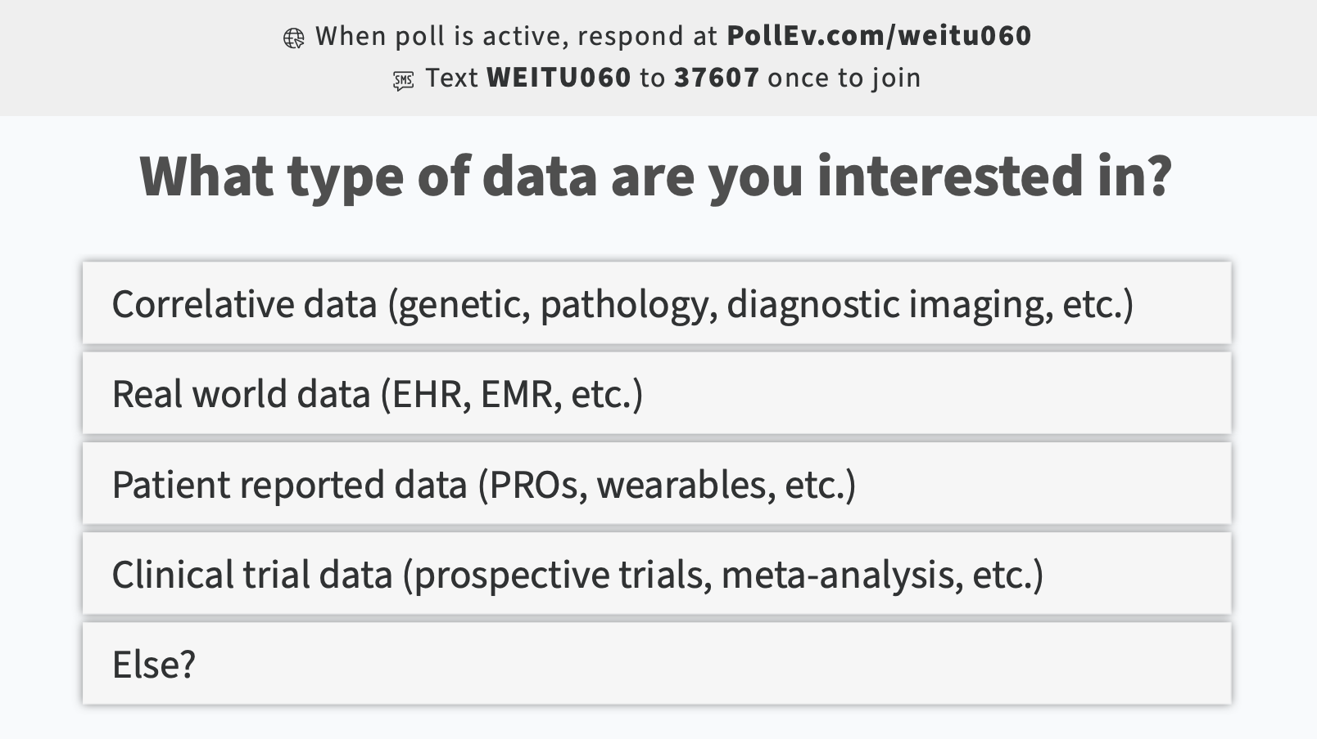
Poll 2

Slide 14
What is Clinical Data?
Clinical data is information gathered for the broad purpose of clinical research on the micro-level (patient care) to the macro-level (broad applications within a health system)
Clinical data is patient data collected throughout the course of patient care, or as part of a formal clinical trial program.

Slide 15
Types of Data
eCRF, IxRS, Supporting/Source Documents, CTMS, etc.
Clinical Trial
Data
Any “Biomarker” done on biospecimens (tissue, blood, cell, spinal fluid, etc.) - Immunohistochemistry results, FISH analysis, cytogenetics, a myriad of genomic testing, metabolomics, proteomics
Central pathology review
Radiomics
Pathological diagnosis
Digital images
Clinical correlates
Electronic health records (EHRs)
Claims and billing activities
Product and disease registries
Patient-generated data including in home-use settings
Data gathered from other sources that can inform on health status, such as mobile devices
CLINICAL
DATA
SCIENCE
Correlative
Science
Data
Real World Data
Patient Reported Data
ePRO, eCOA, screening questionnaire, sensors/wearable devices

Slide 16
Oversight, Operations & Support
Trial Team: Senior Investigator/Data Manager/Monitor/Biostatistician/IT/etc.
Central Office Data Executive Committee
Data and Safety Monitoring Committee (DSMC)
Clinical Trial
Data
CLINICAL
DATA
SCIENCE
Correlative Science and Tumour Biology Committee
Correlative
Science
Data
Committee on Economic Analysis
Real World Data
Data Science Working Group
CCTG Senior Management
Patient Reported Data
Quality of Life Committee
Support Care Committee

Slide 17
Data Science Team
Data Analyst
Business Analyst
S
Supports data science efforts; collect, interpret and maintain data from OS and database; use statistical method and analytical tools to interpret data, prepare dashboards and reports
Sharable, Generalizable, Transparent, Efficient, Knowledge Translation
Evaluate business processes, translate business requirements into analysis plans to support the work of data scientists; convert business expectations into data analysis
Data Engineer
Data Scientist
Application Developer
Build, test, maintain data pipelines, data collection, management and storage; data quality, preparation and model deployment and maintenance; implement, test, and maintain infrastructural components that data architects design
Core team member; utilize statistical methods, other tools to analyze the data, develop models
Develop applications and visualizations for end users
Patients
Clinicians
Correlative Scientists
Statisticians
Clinical Research Associates
AI Researchers
Health Economists
Policymakers
Regulators
Data Architect
Business Manager
Warehouse the data, define database architecture, centralize data, ensure integrity across different sources, performance
Project management, collaborate with Data Scientist and Team

Slide 18
Short Term Goals
Further standardize clinical trial
data plan, collect, organize and analyze
Clinical Trial
Data
CLINICAL
DATA
SCIENCE
Develop protocols, data infrastructure and different correlative data collection, processing, storage and analysis
Correlative
Science
Data
Define policies and workflow of routinely link trial data to cancer and mortality registry data as well as develop infrastructure to secure store sensitive data
Real World Data
Develop a pilot project to highlight the significance and test the infrastructure of the platform
Patient Reported Data
Expand the use and functionality of current CCTG developed patient self-reporting application

Slide 19
Long Term Goals
Standardized, generalizable, scalable, and sharable clinical trial database across trials
Clinical Trial
Data
CLINICAL
DATA
SCIENCE
A standardized and sharable digital data bank including different correlative data for different cancer types
Correlative
Science
Data
A built-in trial component to use RWD as a complement for clinical data to allow long term follow-up and economic analysis
Real World Data
A platform that is available to different users in cancer research and care to collaborate and #SolveCancerTogether
Patient Reported Data
An interactive patient portal that can capture different dimensions of patient outcomes and provide useful knowledge/support/feedback to the patient

Slide 20
Active Projects
Continue use of CDISC in CCTG trials
Dash Sharing Platform
Clinical Trial
Data
CLINICAL
DATA
SCIENCE
LIFE study: Testing feasibility and value of long-term clinical trial follow up using administrative data sources I.e. link clinical trial data with Cancer Care Registry and Statistics Canada census data
Build an inventory of correlative data to identify gaps in standardizing the biomarker validation process
Correlative
Science
Data
Real World Data
A machine learning survival prediction model through multi-scale data integration in mesothelioma
Patient Reported Data
Expanded use of ePROs - SPROUT
Longitudinal online outcome collection from patients in SC.27
Remote symptom monitoring in BL.13F
Virtual delivery of SC intervention in SC.26
Mobile app development in SPROUT.
Planning to use Medidata Patient Cloud module (HN.11)
Portal to allow patients to complete their ePROs, see their outstanding surveys, study materials, etc.

Slide 21
Challenges in Data Science
Data: managing a variety of high volume, velocity data
Adoption: adopting a problem-solving approach
Tools and Technologies: understanding and choosing the right analytical tools and models, keeping up with the latest advancements
Integration and Interoperability: data originating from difference systems and sources
Data Privacy: implementing measures to ensure compliance and data privacy/protection, keeping up with latest regulations
Staff: getting people with the right skill sets to drive the data science initiative and platform

Slide 22
Data Science for Sponsors
Automation of Data Review: Identify data trends and anomalies
Natural Language Processing of Narratives: Extract annotated data from unstructured clinical text to streamline the process and accuracy of data review
Vendor Oversight: Data-driven insights on performance related to vendor service on multiple trials
Audit Trail Review: Identify actions not performed by authorized individuals, timing of data entry (e.g. all-at-once/batch entry vs timely entry per protocol)
Chatbot User Support: Domain-specific chatbots to provide automated user support based on frequent, common questions to provide solutions

Slide 23
Data Science for Sites
Medical Image Analysis: Advanced techniques to enhance image analysis, detect abnormalities/deformities
Natural Language Processing of Narratives: Extract annotated data from unstructured clinical text to gain more insight into the overall patient care experience
Monitoring Patient Health: Wearable devices, symptom reporting, etc. can help physicians monitor patients real-time (as initiated by trial sponsor in some cases)
Social Media: Many platforms can target a wider range of potential patients
Virtual Care: Comprehensive platform to support patient care, self-monitoring, online assistance

Slide 24
Review of Learning Objectives
To understand the how clinical data sciences can support the collection, management, and analysis of clinical data
Defined data science, how it applies to clinical trials, data sources and types, teams involved
To review the current adoption of data science at CCTG
Reviewed CCTG’s active projects
To review the future of data science at CCTG
Reviewed CCTG’s short and long-term goals, potential uses for clinical trial sponsors and sites

Slide 25
Discussion
What other potential areas, applications, projects do you see for clinical data science?

Slide 26
Thank you!

